Slide 1




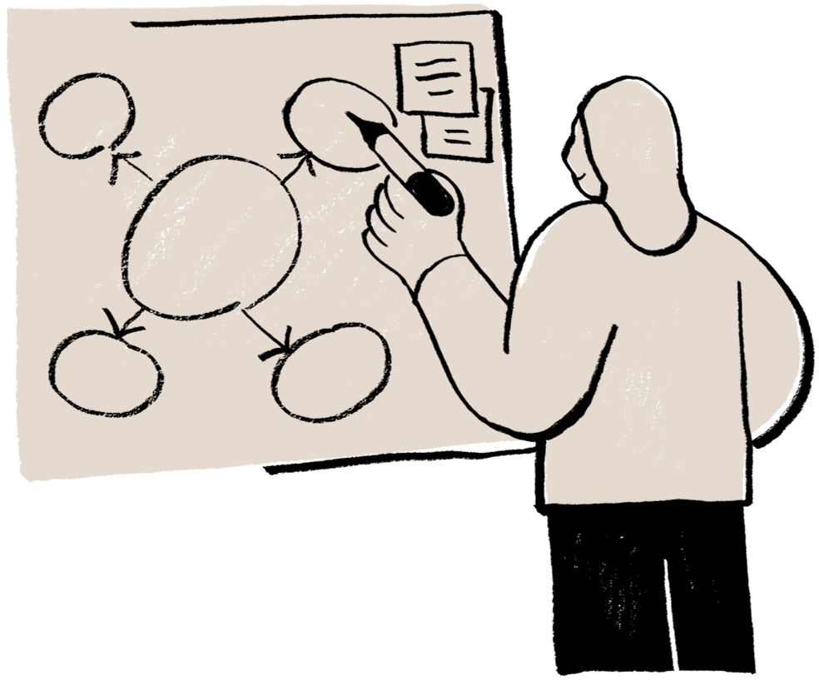

Team 2
Micro Project - 2025
FARIZA SAYYED –25R21A05EF
SHIVANI KUMAR–25R21A05EJ
ROUNAK JAT–25R21A05EC
S.JOEL ALEX–25R21A05EE
MOGILI AVINASH-25R21A05DY
PEDDI REVANTH- 25R21A05E8
DIY EMERGENCY POWER BOX
CLASS-SECTION:CSE-D

Slide 2


CIE.
Problem Statement
Frequent power cuts affect charging of
essential devices.
- Lack of an adjustable portable power
source in emergencies leaves devices l
like routers, LEDs,and phones
unusable
Need a compact emergency backup tool
for students and homes.
2025

Slide 3

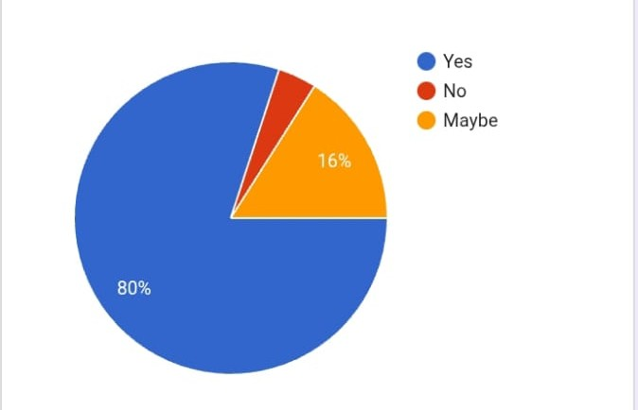
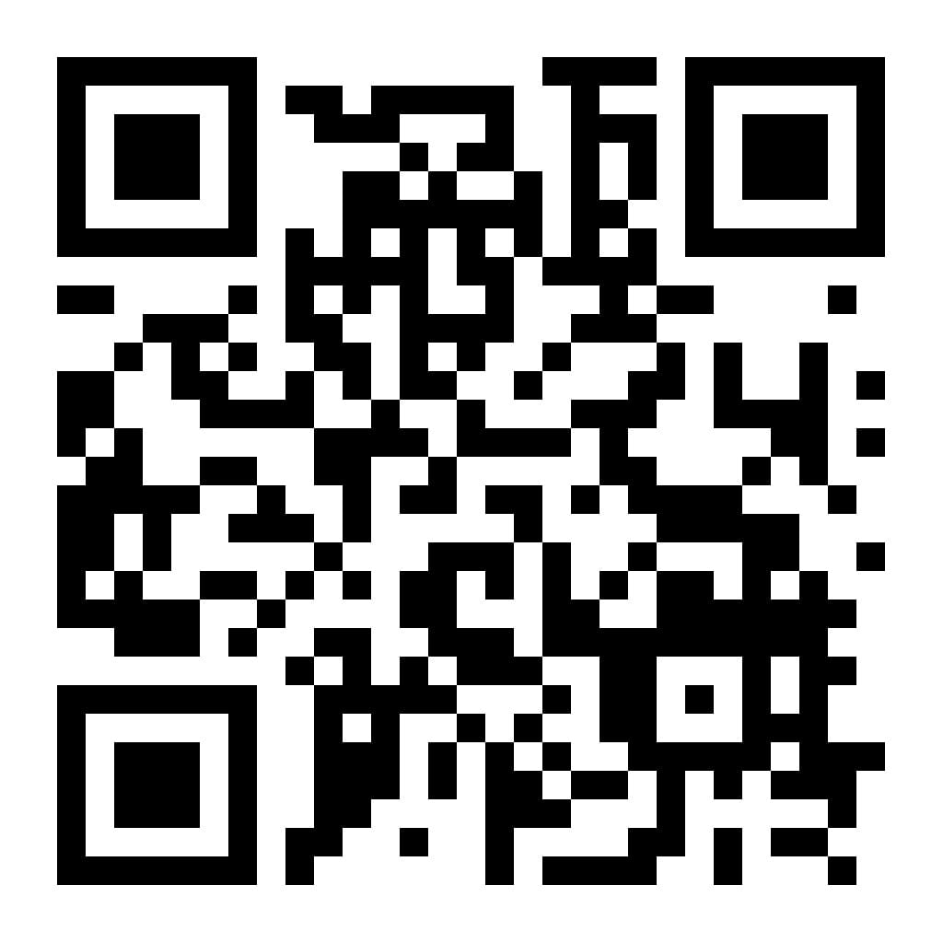

Customer Survey
KEY INSIGHTS
Have you ever wished for small portable power source during emergencies?
  52% of the students needs power bank during a power cut.
  60% of the students would use this emergency power box in college.
  76% of the students faces frequent power cuts.
  52% of the students have never heard about emergency power box.
CIE.
2025

Slide 4

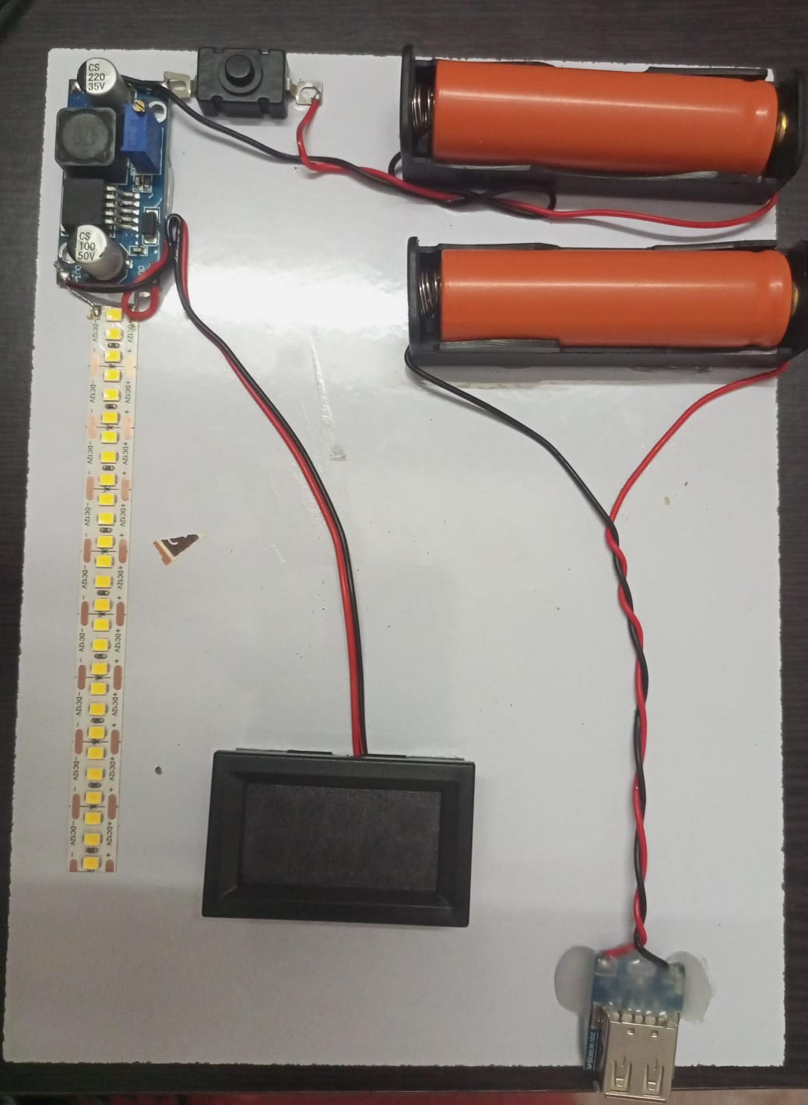
CIE.
Prototype & Solution
Prototype
Prototype built with Li-ion cells, USB module, XL6009 booster, voltmeter, switch and LED strips assembled to provide a stable portable power output.
  .
Our Solution – DIY Emergency Power Box
Compact power box with USB charging and adjustable output via XL6009.Built-in voltmeter displays accurate voltage . Runs on rechargeable 18650 cells to power routers, LEDs, and small devices.
2025

Slide 5


CIE.
Existing Solutions
Innovation at work
Brands: Jackery , EcoFlow , Bluetti , Anker Features: Lithium battery, AC/DC USB
outputs, solar charging
Price: ₹25,000–₹80,000
Pros: High capacity, sleek design, multi-
device support
Cons: Expensive, not DIY-friendly, limited
customization
Compact & low‑cost emergency backup.
Rechargeable lithium battery
system.
Multi output : 5V USB output and
adjustable DC voltage .
- Easy to repair and modify.
2025

Slide 6
CIE.
Product Overview
Product Overview
- Provides emergency backup when power fails.
- Suitable for students, labs, and small electronics.
- Adjustable output prevents device damage.
- Lightweight & portable.
- Battery-powered, no external power needed
2025

Slide 7


CIE.
SWOC Analysis
Strengths
Opportunities
• Portable
• Multi‑function
• Low‑cost
• Easy to build
Expand to solar‑charging
Add USB‑C fast charging
SWOC
Weaknesses
Challenges
• Battery safety
• Heat during boosting
• Limited capacity
• Manual voltage adjustment
2025

Slide 8
(BMC) Business Model Canvas
CIE.
Cost Structure
Total cost: ₹ 800
Customer segment
Key Resources
Total cost :₹ 800
•Rechargeable battery & holder
• Boost/USB module, voltmeter, switch
• Basic wiring tools for assembly
Households with power cuts
2. Students & DIY
users
Outdoor users & small vendors
Revenue Streams
DIY kits and training workshops.
School bundles and custom builds for NGOs/businesses.
2025

Slide 9
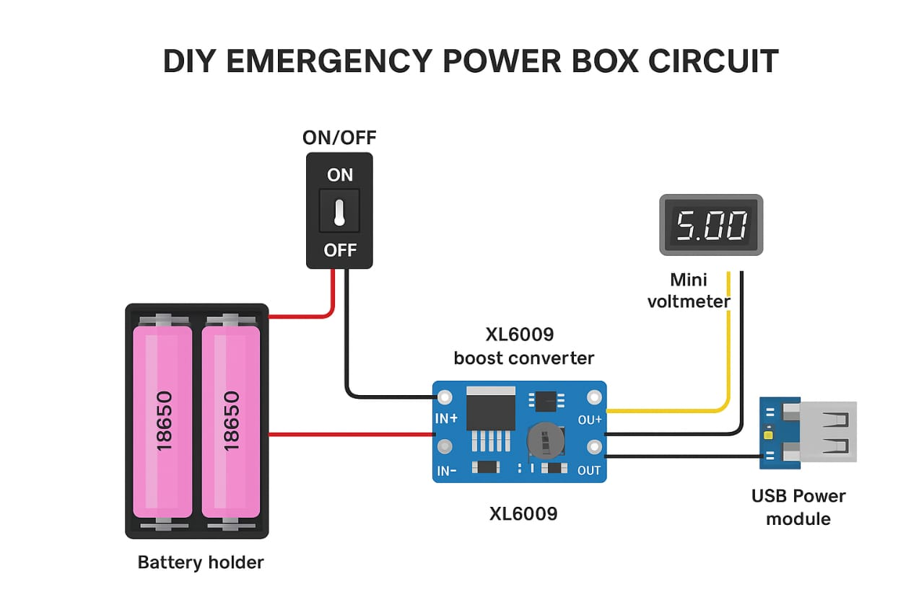

:
CIE.
.
.
CIRCUIT DIAGRAM
2025

Slide 10
:
CIE.
.
Tech & Component Overview
.
Converters: XL6009 Boost Module
Power Source: 2 Li‑ion Cells
Display: Digital Voltmeter
Charging: USB Power Bank Module
Body: Acrylic Base
Future Scope & Next Steps
• Add solar charging input
• Integrate LiFePO4 cells for higher safety
• Add digital wattmeter for current monitoring
• Add enclosure for durability
• Increase battery capacity
2025

Slide 11






THANK YOU!
Do you have any queries?
CIE.
2025

